Slide 1


ML
READ HANDWRITING
Nod Coding Bootcamp
By:
Jim Rehnqvist
2022

Slide 2

01
OVERVIEW
What is it?
Why is it?
How does it work?

Slide 3
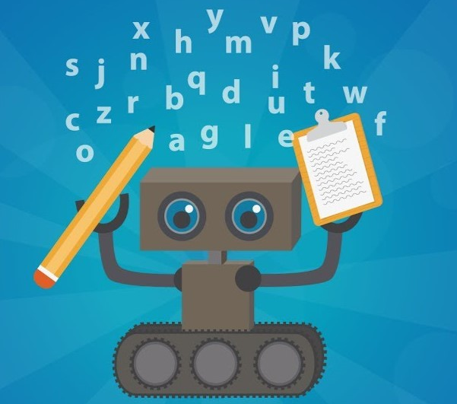


What is it?
Why?
My little AI
He's 3 days old.
Don't be too hard on him
It's an AI that takes a pictures of handwritten text and turns it into text document
We still write a lot by hand and typing it into a computer takes too long

Slide 4

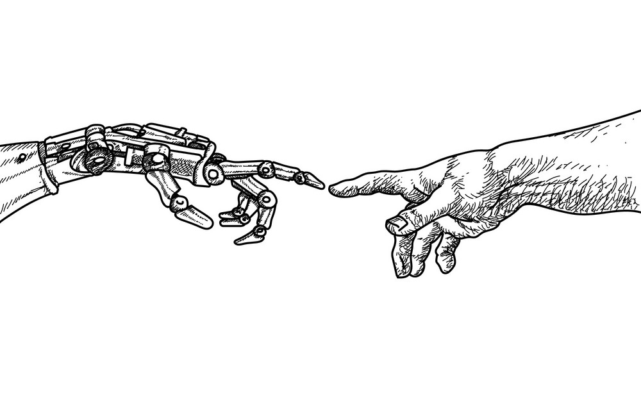
How does it work?
Step 1: Take picture and give it to the AI
Step 2: Image Preprocessing
Step 3: Find Words
Step 4: Read words
Step 5: Write words

Slide 5
02
LET'S DIVE DEEPER
How does it work?
(In detail)

Slide 6

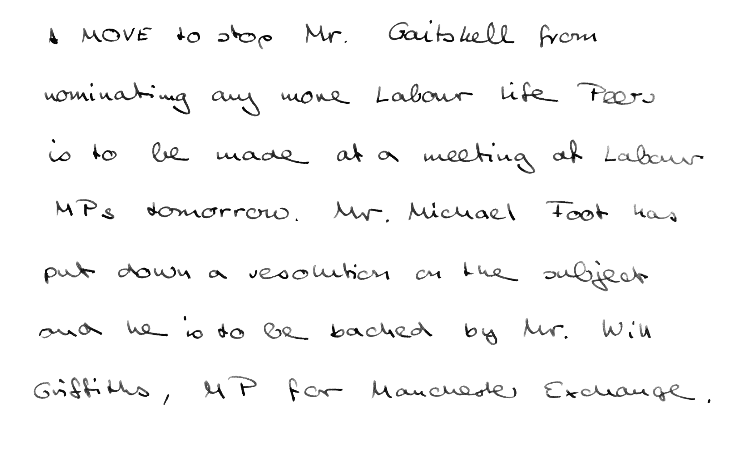
Upload
Step 1
The easy stepp
Take a picture (Only PNG at the moment)
Upload

Slide 7
Preprocess (OpenCV)
Step 2
Preprocess (if needed)
Contrast
Light
Rotation
Crop image

Slide 8
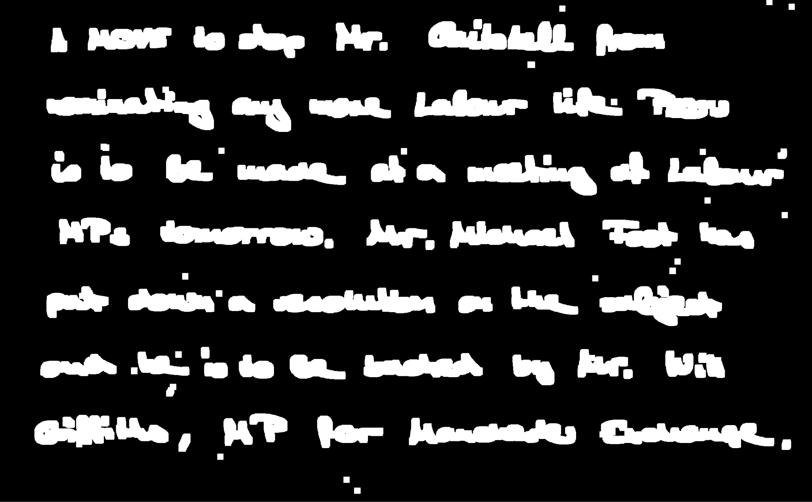
Find Words (OpenCV)
Step 3
Find contours

Slide 9
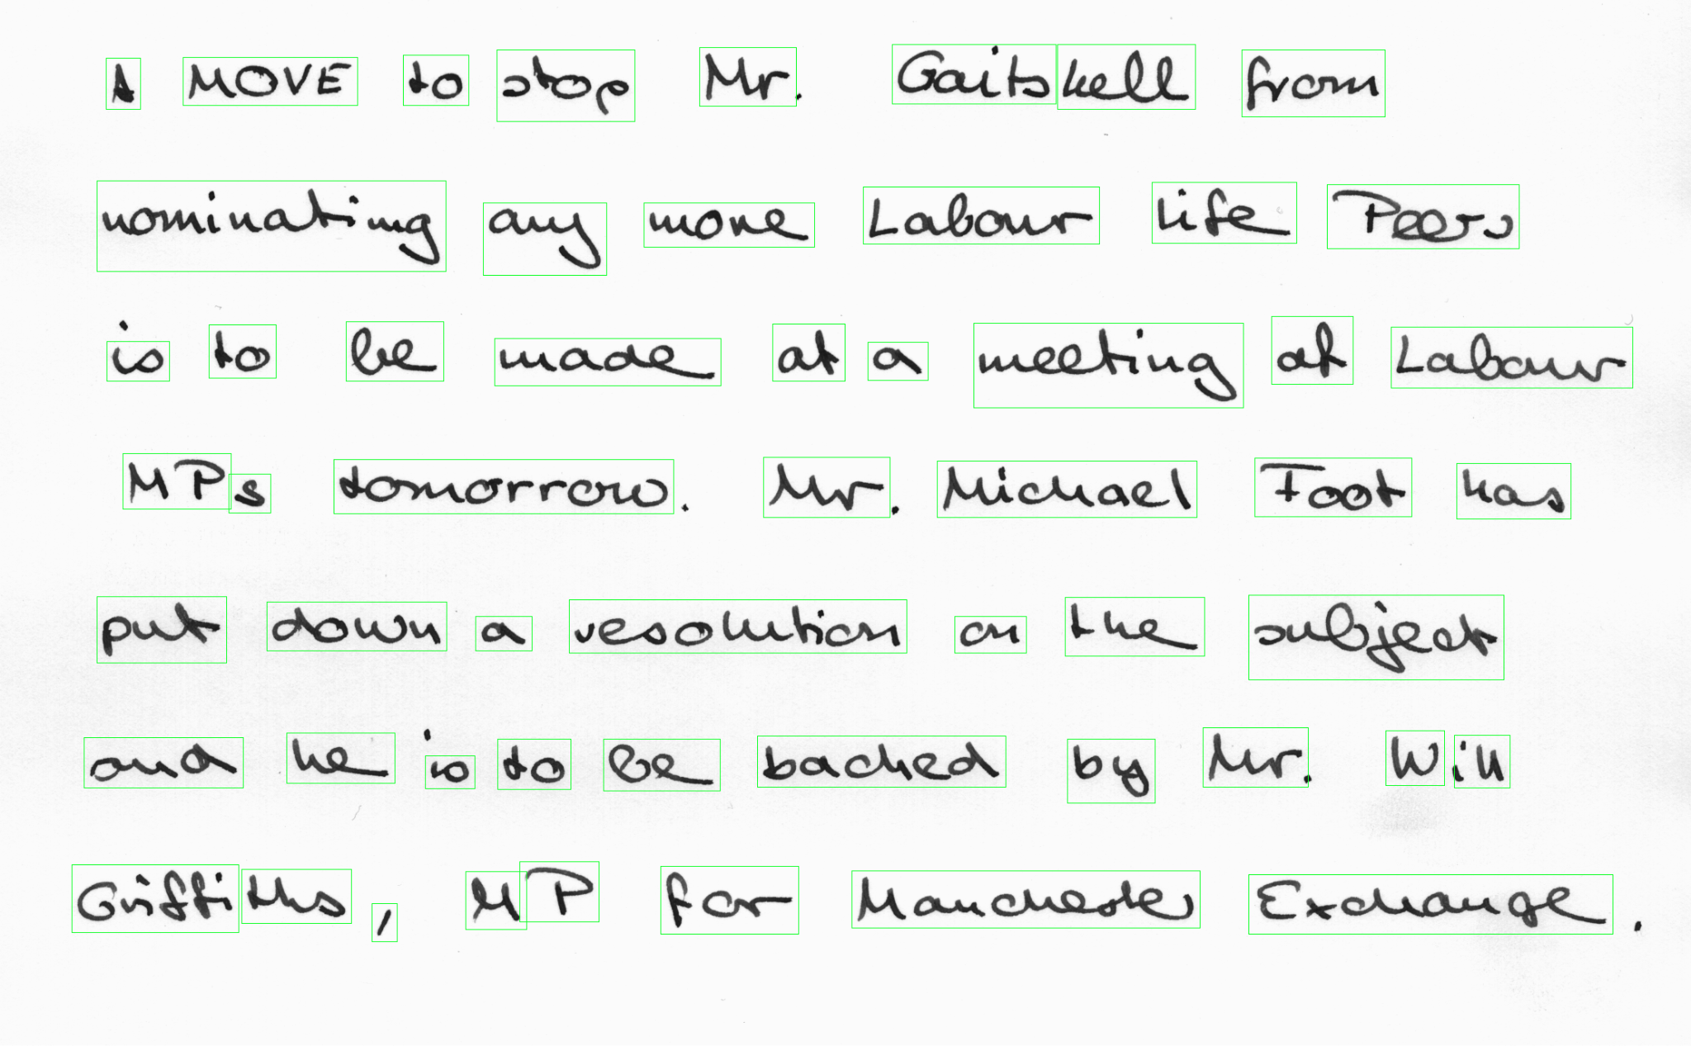
Find Words (OpenCV)
Step 3
Find contours
Select contours

Slide 10
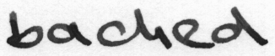
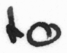
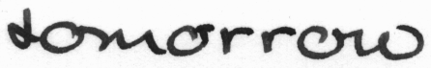
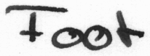
Find Words (OpenCV)
Step 3
Find contours
Select contours
Save selection

Slide 11
Read Words
(Tensorflow)
Step 4
AI reads the words

Slide 12
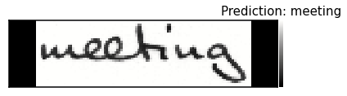
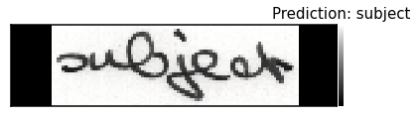
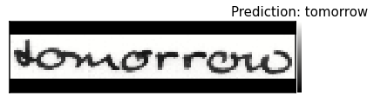
Read Words
(Tensorflow)
Step 4
AI reads the words
Predict word

Slide 13
Write Words
Step 5
Saits hell Mr. stop from to mOvE A nominating life Treers Labour ay more of be meeting at to tabour made to a MP Mr Foot tomorrous Michael has 's subijeat put the sesolution down a on Mr. w he in backed on to be by to B brigfi for ths Mancharter It Exchange ,
AI writes to a text document
This part needs some work

Slide 14
03
The AI
How does that work?

Slide 15
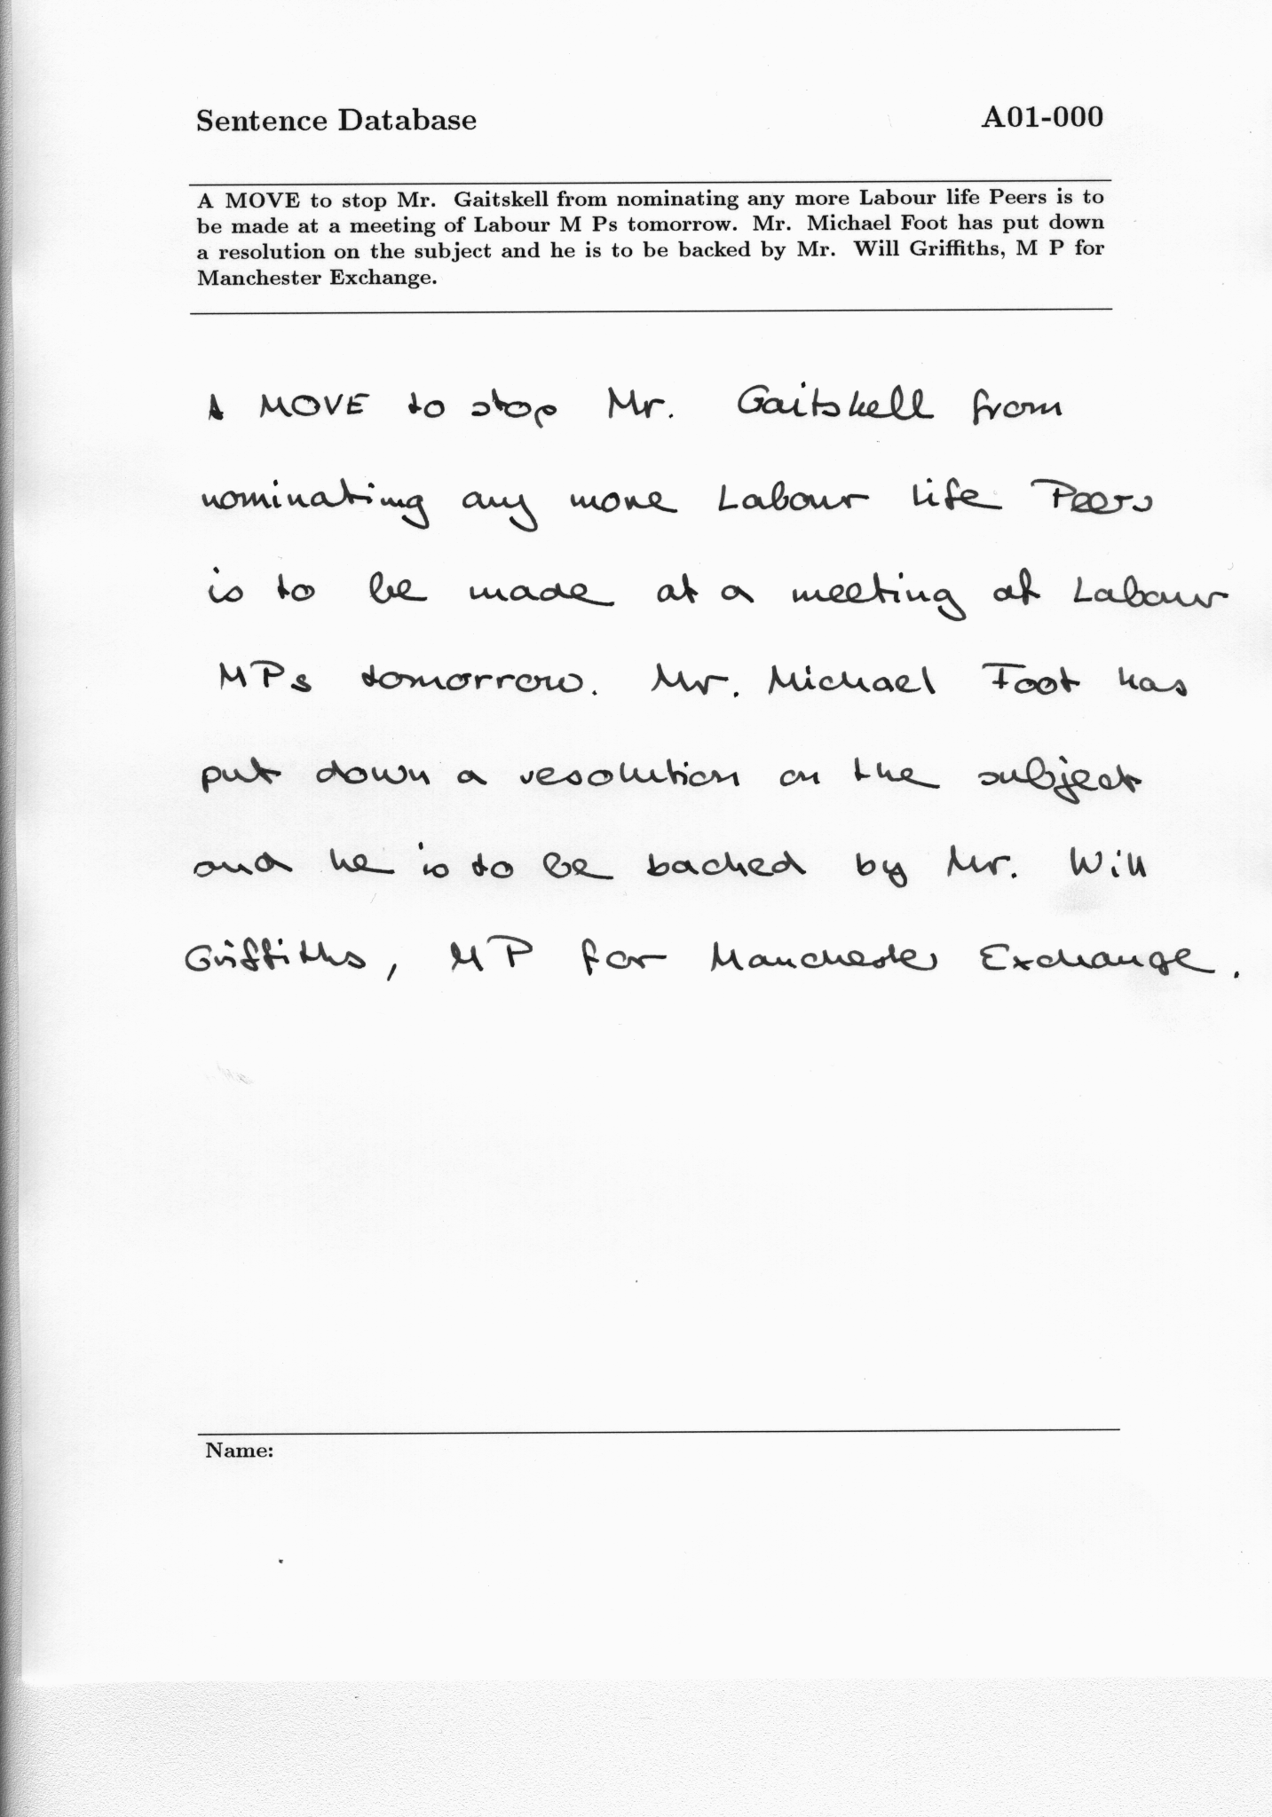
Data
IAM Handwriting Database https://fki.tic.heia-fr.ch/databases/iam-handwriting-database
Split into words
Image of word and label
Train Test split
Character vocabulary
Tensorflow
Image Preprocessing
Build model
Epochs “loops”
529 Forms
115 321
Word images

Slide 16
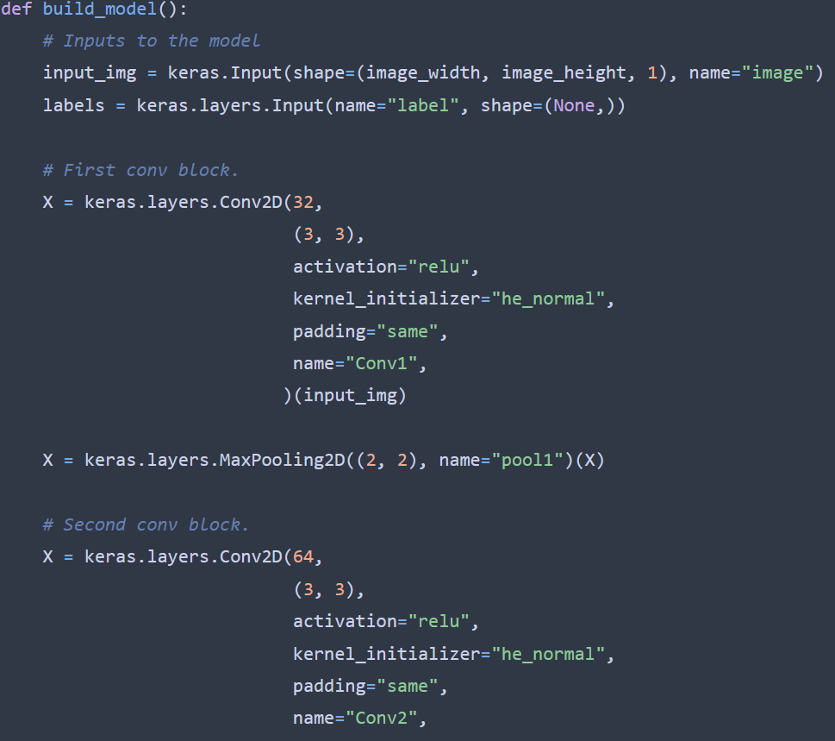
Model
Tensorflow (Keras)
Image Preprocessing
Build model
Epochs “loops”
code snippet

Slide 17
04
Challenges Highlights

Slide 18
Challenges
Highlights
Understanding Tensorflow
Select words from image
Training the model (Crashed my laptop)
Jupyter notebook (stopped working randomly)
First model
First prediction

Slide 19
06
Let's try it
If we have time

Slide 20
07
Questions?
Ask me anything

Slide 21
Thank you for listening!!!
Nod Coding Bootcamp
By:
Jim Rehnqvist
2022

